Slide 1
FARMER’S HELP
SOUVIK MANDAL

Slide 2
Technologies Used
HTML & CSS (Frontend)
Python (Backend)
ML(Deep Learning)
Image Processing (TensorFlow)
Hierarchical Data Format HDF (.h5)

Slide 3
Hierarchical Data Format HDF (.h5)
Store large amount of data
In the form of multidimensional arrays
Store two primary types of objects:
Datasets and Groups
Dataset is essentially a multidimensional array
Group is a structure for organizing objects in an HDF5 file

Slide 4
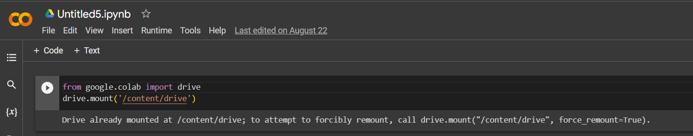
Google Colab
We import google drive first
Then mount the my google drive in google colab notebook

Slide 5
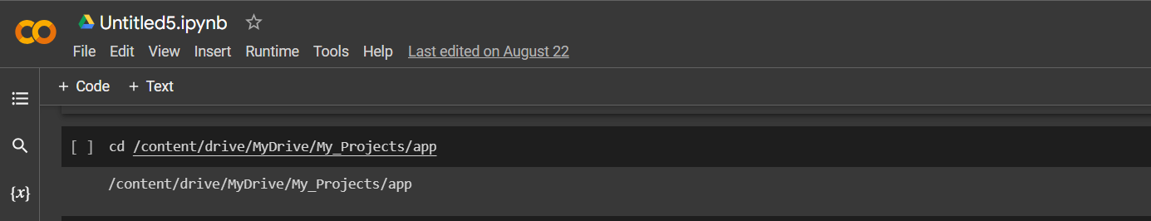
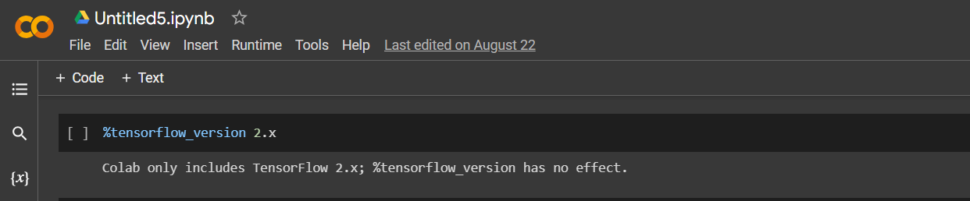
I mounted the google drive folder where I store the data set
I used the TensorFlow version 2.x

Slide 6
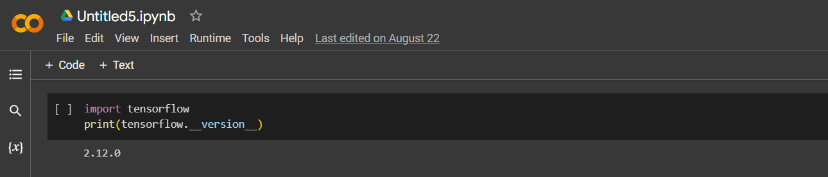
Now we import TensorFlow library
Showing TensorFlow version also

Slide 7
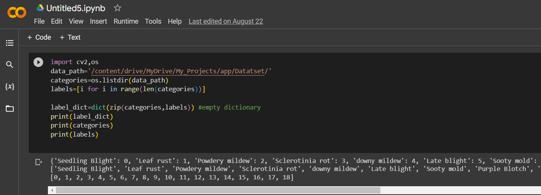
Imported OpenCv as CV2 to process image
Imported OS to access the google drive directory
Finally create a dictionary to make a data set.

Slide 8
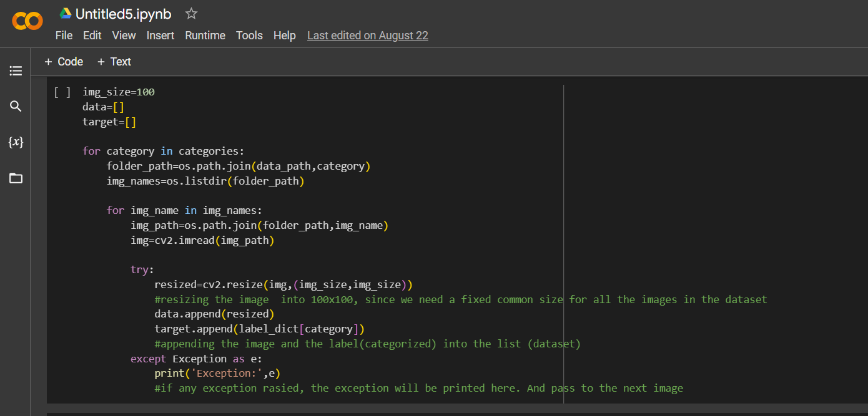
Here we resize every image in data set to 100*100 pixel
And add to the new list “data” .

Slide 9
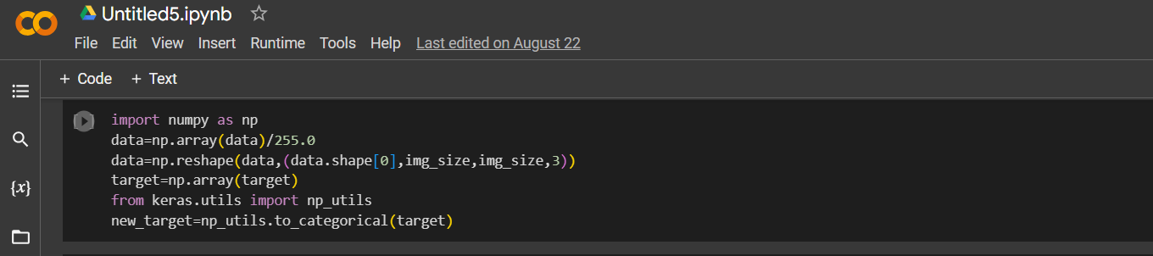
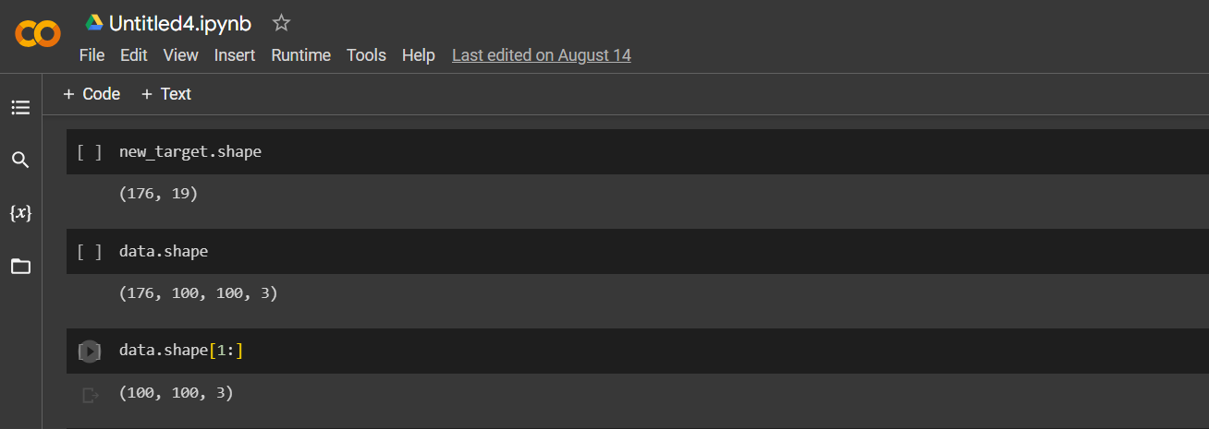
I used numpy library for calculation
Import keras for layers of models.

Slide 10
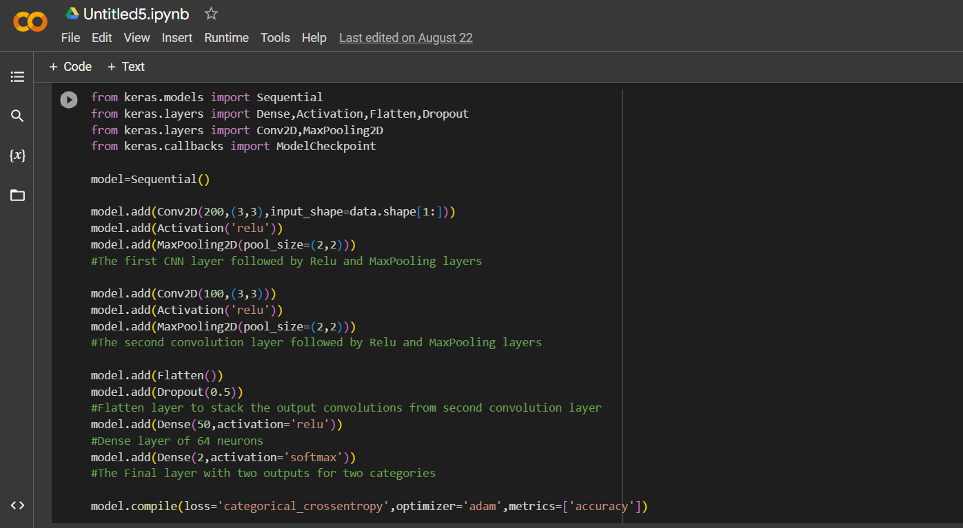
Imported Sequential, Dense, Activation, Flatten, Dropout, Conv2d , Maxpooling2d, Modelcheckpoint functions

Slide 11
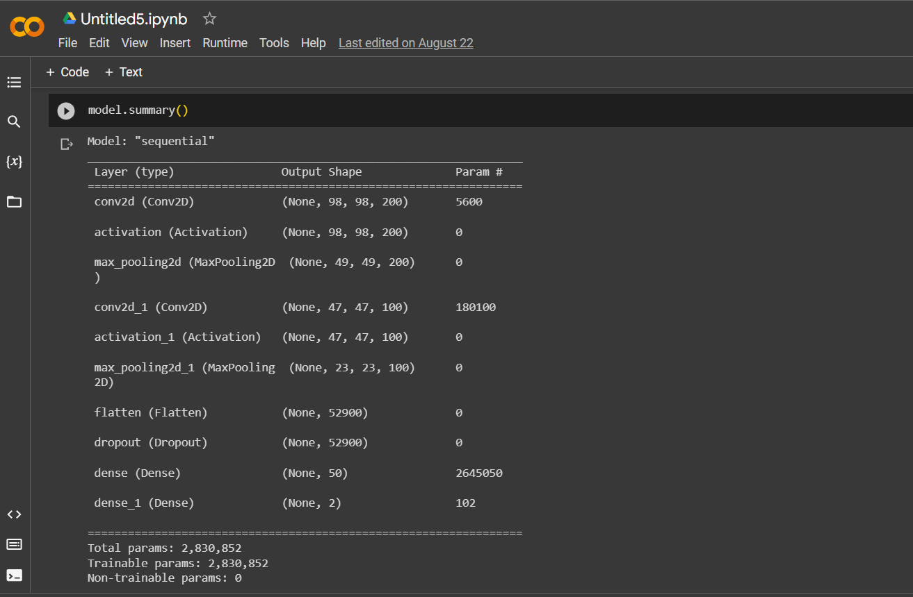
Now we go for the model summery

Slide 12
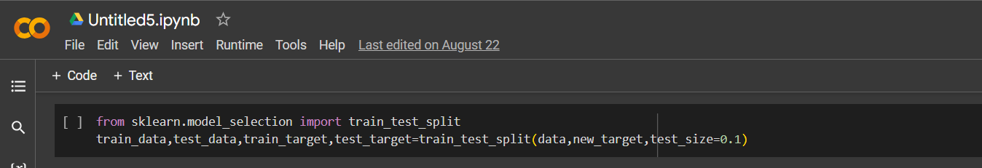
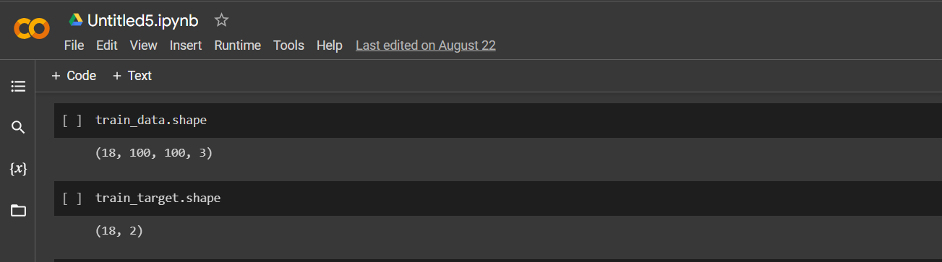
Now we imported sklearn library which is generally used for statistical modelling like regration, classification, clustering, etc but in my project we used for classification.

Slide 13
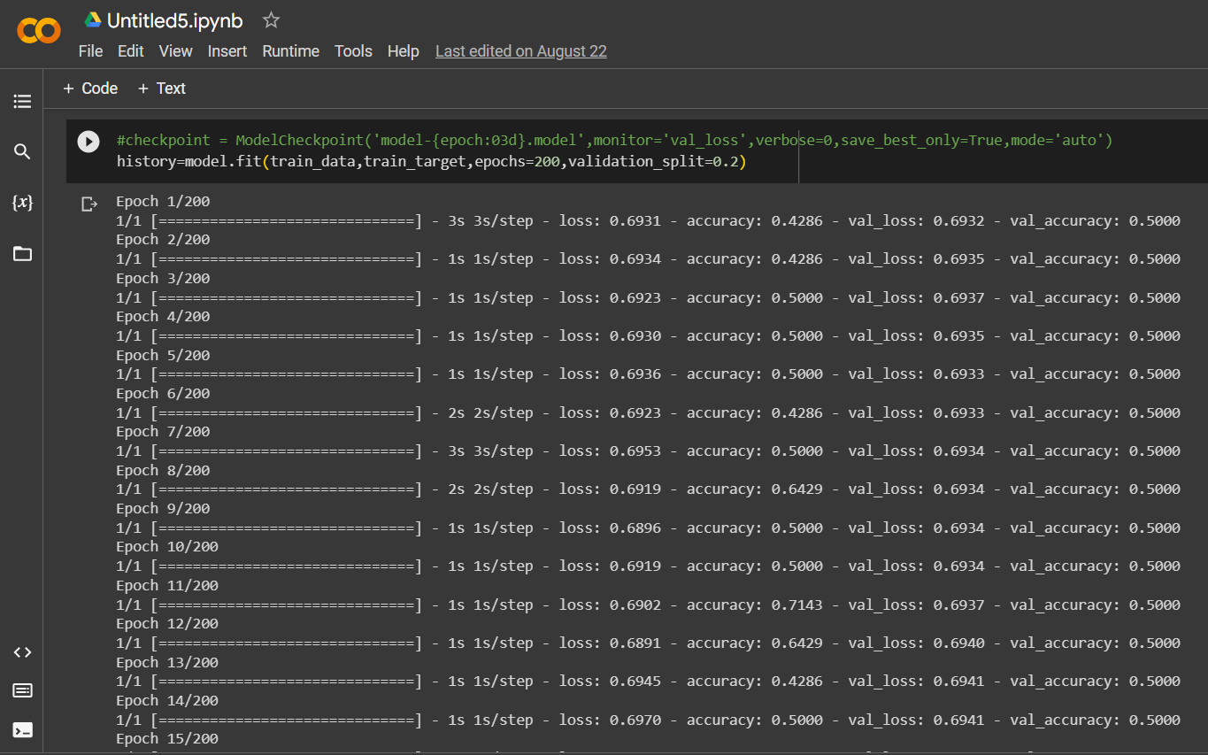
Finally we start training with epochs 2 and validation_split 0.2

Slide 14
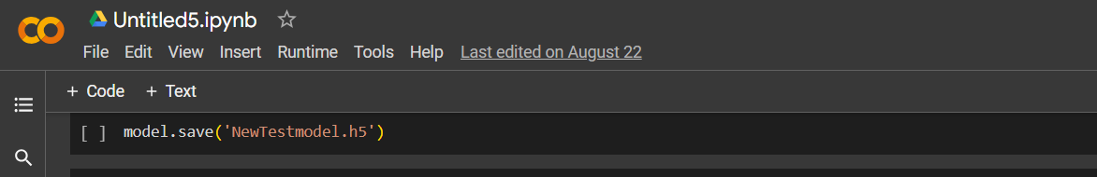
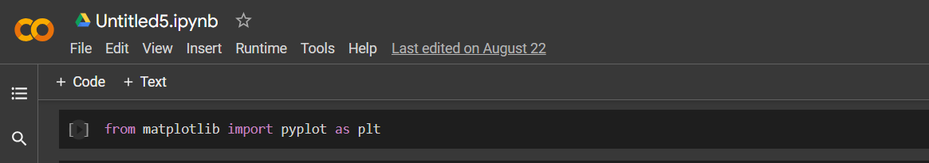
After completion of training we save the model in .h5 format
Imported matplotlib library to implement visualization report like line plot, histogram, bar chart, pi chart, box chart, etc.

Slide 15
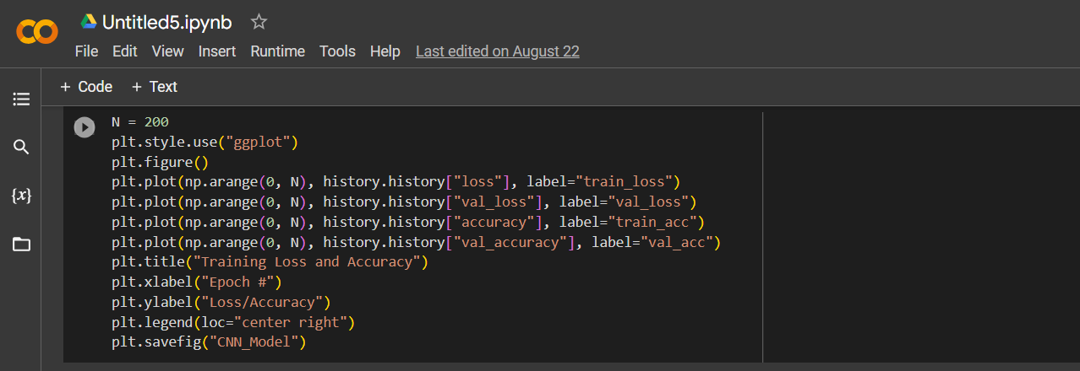
Now we use 200 data elements
Plot the graph that shows the accuracy
It determines the data loss also

Slide 16
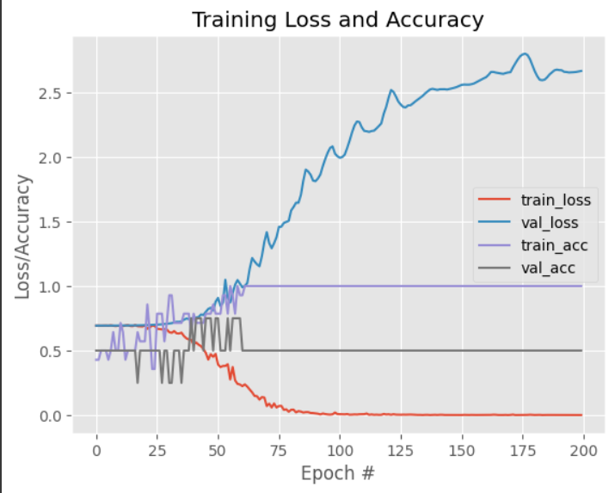
This chart describes about data loss and accuracy.

Slide 17
Thank You

